Slide 1
SLAM Techniques
-Venkata satya jayanth Vuddagiri

Slide 2
What is SLAM
Stands for simultaneous localization and mapping.
Its more of a concept than an algorithm.
It consists of different type of steps and these steps can be implemented by a number of different algorithms.

Slide 3
What is SLAM
SLAM is two fold as the name suggests, it needs to construct or update map of an environment while simultaneously keeping track of the object location.
SLAM is initially compared to a chicken and egg problem.

Slide 4
Chicken and Egg problem
It is the problem of building a map while at the same time localizing the robot within that map
In practice, these two problems cannot be solved independently of each other
Before a robot can answer the question of what the environment looks like given a set of observations, it needs to know from which locations these observations have been made.

Slide 5
Chicken and Egg problem
At the same time, it is hard to estimate the current position of a vehicle without a map.
Hence the comparisons with chicken and egg problem.
A good map is needed for localization while an accurate pose estimate is needed to build a map.

Slide 6
Steps in SLAM
Landmark Extraction.
Data association.
State estimation.
State update.
Landmark update.

Slide 7
Hardware:
Mobile robot to test the algorithms and programs
Range measurement devices:
Laser scanner – Cant be used in underwater and foggy environments
Sonar – not exactly accurate
Vision – needs a constant light source

Slide 8
Landmarks
Landmarks are features which can easily be re-observed and distinguished from the environment.
These are used by the robot to find out where it is (to localize itself).

Slide 9
Characteristics of a good landmark:
Landmarks should be easily re-observable.
Individual landmarks should be distinguishable from each other.
Landmarks should be plentiful in the environment.
Landmarks should be stationary.

Slide 10
Landmark Extraction
Once the types of landmarks are decided by the user, we need to successfully extract them from the robot’s sensory inputs
The algorithms that are used in landmark extraction are spikes and RANSAC

Slide 11
Spikes
Spike landmark extraction is a simple algorithm concerned with landmark extraction from laser or sonar scan range data.
In scanning systems where scans yield multiple values within a certain angle of scanning, this algorithm tries to find extreme differences in the values read by the scanners

Slide 12
Spikes
This happens when the distance measured at one angle is different to the distance measured at the next angle.
Which in turn indicates that there is a geometric change between the angles, which can be interpreted as a landmark.

Slide 13
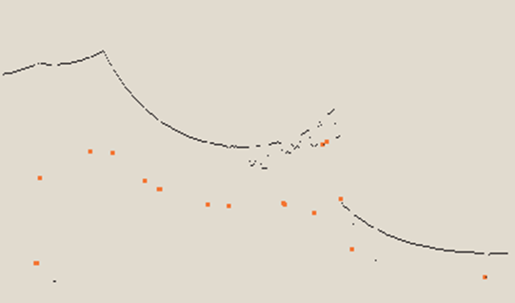
Spikes
It relies a lot of environment changing between two beams. This means that the algorithm will fail in smooth environments.

Slide 14
RANSAC (Random Sampling Consensus):
This method can be used to extract lines from a laser scan that can in turn be used as landmarks.
RANSAC finds these line landmarks by randomly taking a sample of the laser readings and then using a least squares approximation to find the best fit line that runs through these readings.

Slide 15
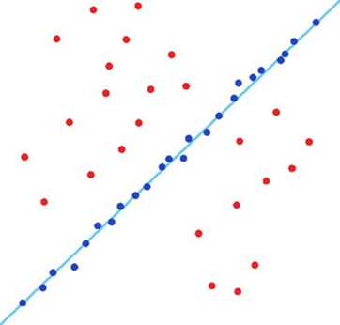
RANSAC (Random Sampling Consensus):

Slide 16
Data Association
The problem of data association is that of matching observed landmarks from different (laser) scans with each other.
Problems in Data Association
You might not re-observe landmarks every time.
You might observe something as being a landmark but fail to ever see it again.
You might wrongly associate a landmark to a previously seen landmark.

Slide 17
Algorithm – Nearest Neighbor Approach
When you get a new laser scan use landmark extraction to extract all visible landmarks.
Associate each extracted landmark to the closest landmark we have seen more than N times in the database.
Pass each of these pairs of associations (extracted landmark, landmark in database) through a validation gate.

Slide 18
Algorithm – Nearest Neighbor Approach
If the pair passes the validation gate it must be the same landmark we have re-observed so increment the number of times we have seen it in the database.
If the pair fails the validation gate add this landmark as a new landmark in the database and set the number of times we have seen it to 1.

Slide 19
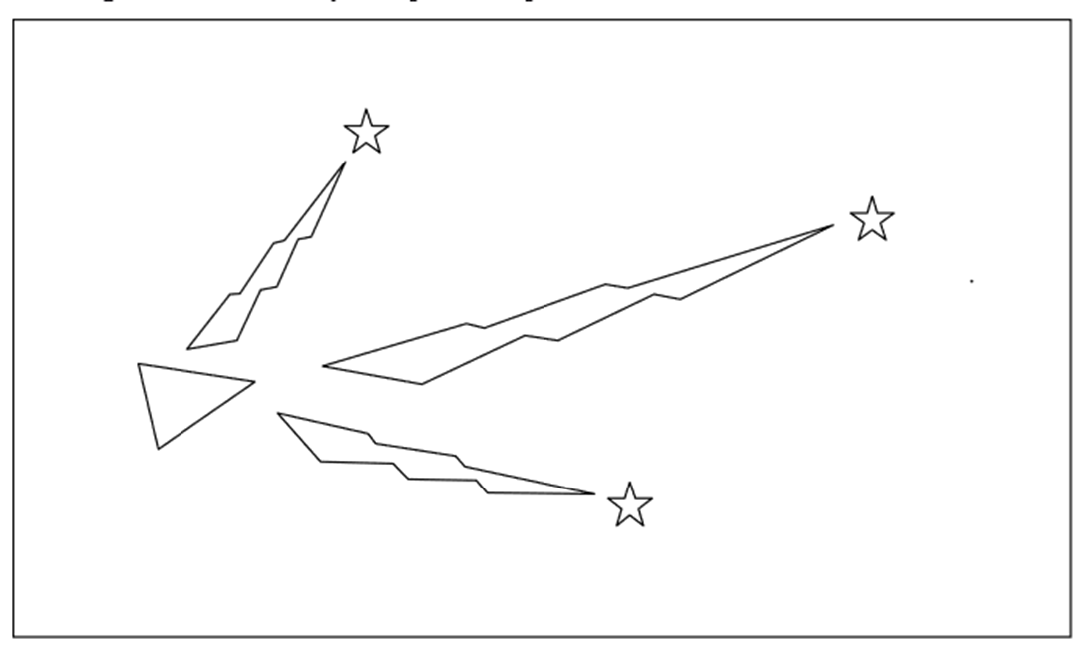
Basic principle of SLAM
Stars represent landmarks, initially position is estimated by sensors

Slide 20
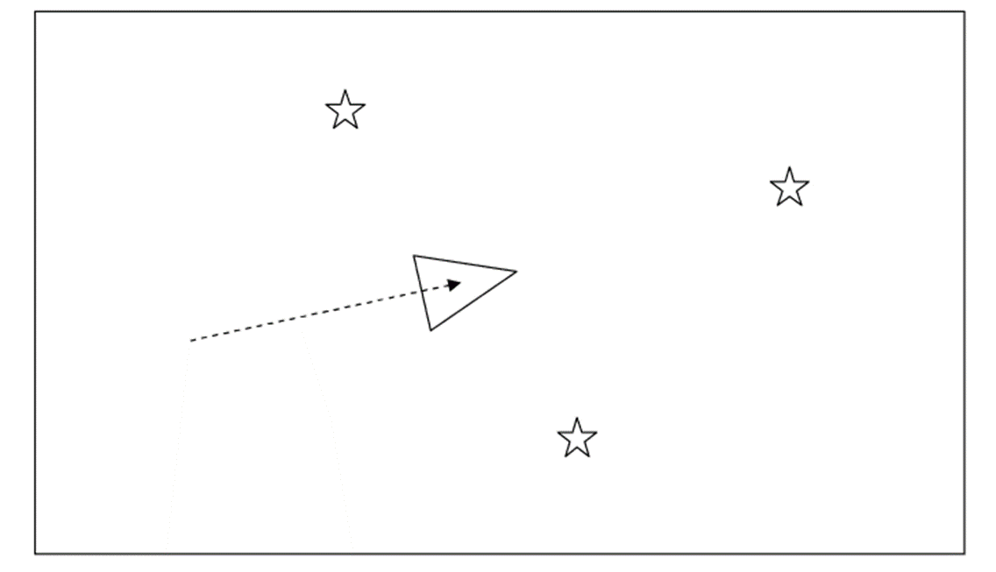
Basic principle of SLAM
The robot moves and it now thinks it is here, distance given by odometry alone

Slide 21
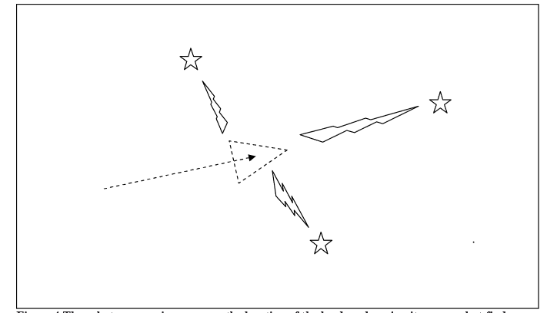
Basic principle of SLAM
Robot measures distance now using sensors and landmarks

Slide 22
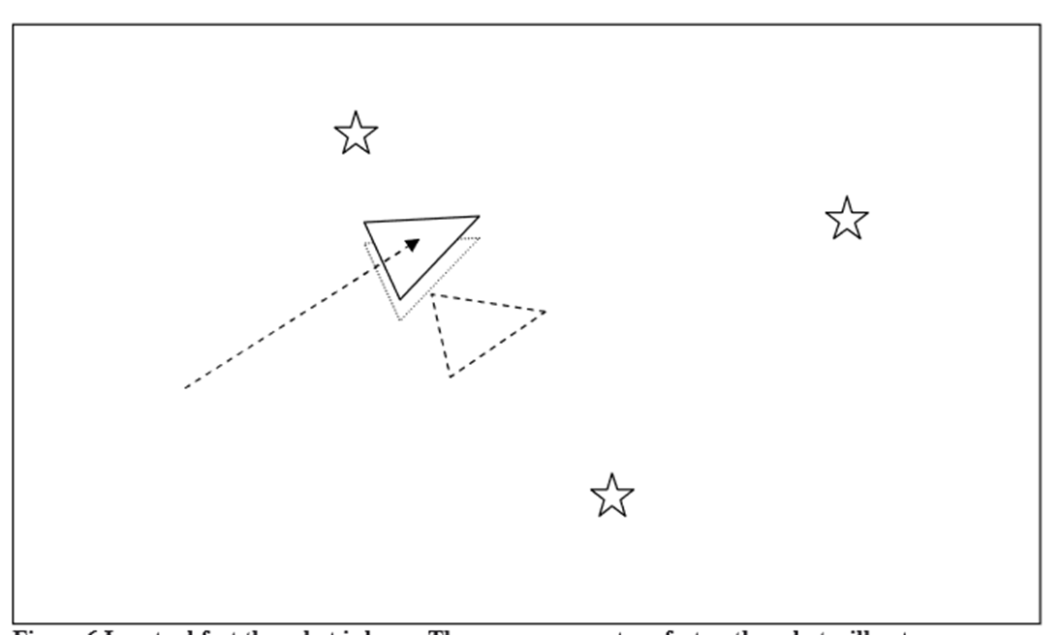
Basic principle of SLAM
Robot starts relying more on sensors than odometry. The dotted triangle represents where it thinks it is while the solid triangle shows where exactly the robot is.

Slide 23
Extended Kalman Filter (EKF):
The Extended Kalman Filter is used to estimate the state (position) of the robot from odometry data and landmark observations.
The EKF is usually described in terms of state estimation alone.

Slide 24
Overview of the process in EKF
Update the current state estimate using the odometry data.
Update the estimated state from re-observing landmarks.
Add new landmarks to the current state.

Slide 25
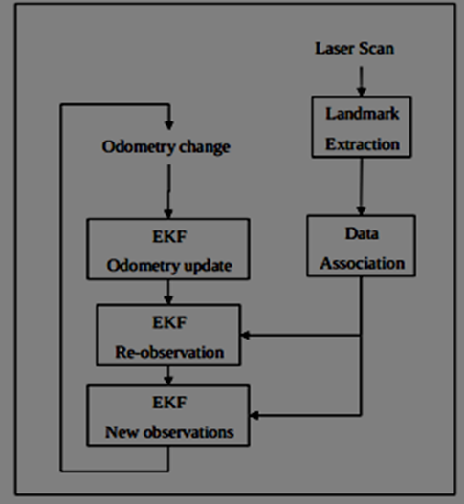
Overview of SLAM using EKF
SLAM cannot be based on odometry alone
Correction of robot’s position is achieved by observing the robots position
EKF is responsible for updating the robots position and also keeps track of the estimate of the uncertainty in the robots position and also the uncertainty in these landmarks it has seen in the environment

Slide 26
Applications of SLAM
Autonomous vehicles
UAV’s
Autonomous Underwater vehicles
Planetary rovers
Domestic robots like Roomba
Self driving cars

Slide 27
Limitations
Multiple objects (confusing landmarks)
Moving objects (vehicles or pedestrians)
Underwater environments
Complexity
Computational power

Slide 28
References
‘FastSLAM: A Factored Solution to the Simultaneous Localization and Mapping Problem’- Michael Montemerlo and Sebastian Thrun, Daphne Koller and Ben Wegbreit
‘Simultaneous Localisation and Mapping (SLAM): Part I The Essential Algorithms’ - Hugh Durrant-Whyte
‘Simultaneous Localization and Mappin part 2’ - Hugh Durrant-Whyte, Tim Bailey
‘Real-Time Simultaneous Localisation and Mapping with a Single Camera’ - Andrew J. Davison
‘Optimization of the Simultaneous Localization and Map-Building Algorithm for Real-Time Implementation’- José E. Guivant and Eduardo Mario Nebot

Slide 29
THANK YOU !

